Slide 1
Master of Science in Computer Science and Engineering
A Trusted and Privacy-Enhanced In-Memory Data Store
Miguel de Lemos Dias Rosa Anciães
Adviser:
Henrique Domingos
27 February 2020

Slide 2
Outline
Dissertation Plan
Context and Motivation
Problem
Objectives and Contributions
Related Work
System Model and Architecture
Approach to Elaboration Phase
Architecture Components and Implementation Guidelines
Testing Environments
Evaluation Criteria
Work Plan
Conclusion
References

Slide 3
Outline
Dissertation Plan
Context and Motivation
Problem
Objectives and Contributions
Related Work
System Model and Architecture
Approach to Elaboration Phase
Architecture Components and Implementation Guidelines
Testing Environments
Evaluation Criteria
Work Plan
Conclusion
References

Slide 4
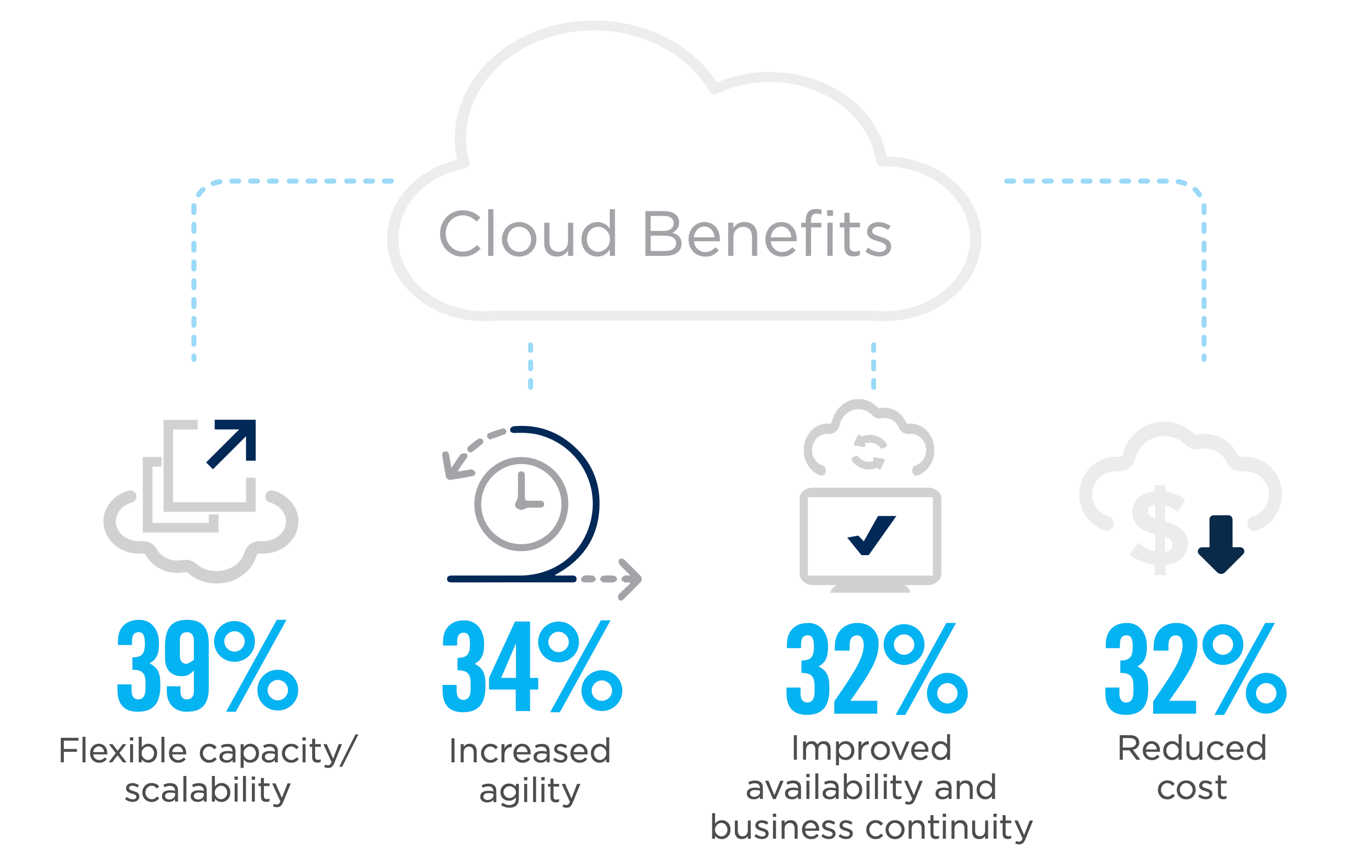
Cloud Benefits
Context and Motivation
Source: isc2.org
Notes:
Capacidade de escalbilidade flexivel
Aumento da rapidez de deployment de aplicações
Melhor continuidade dos servicos
Redução custos

Slide 5
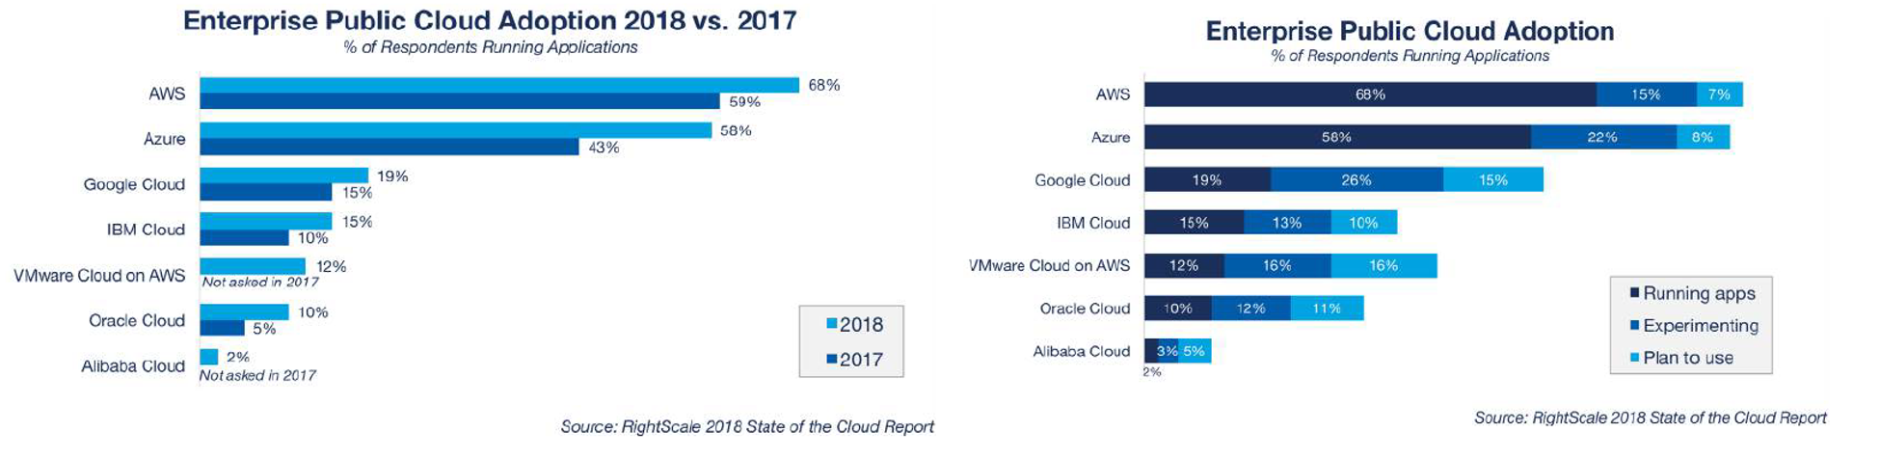
Cloud Adoption
Context and Motivation
Notes:
Aumento do uso de cloud de ano para ano em todos os provedores de cloud.
Muita gente a experimentar e que planea usar

Slide 6
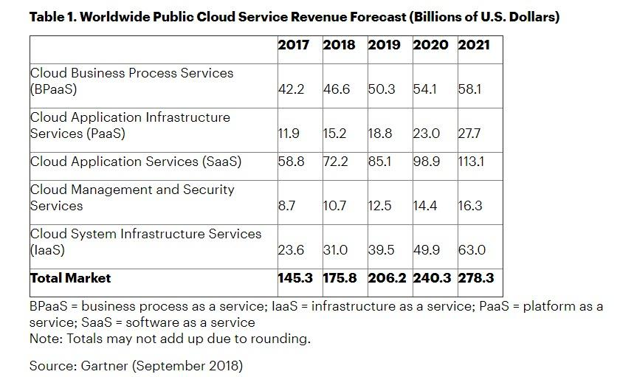
Cloud Revenue
Context and Motivation
Notes:
Aumento do Lucro dos provedores de cloud ano para ano

Slide 7
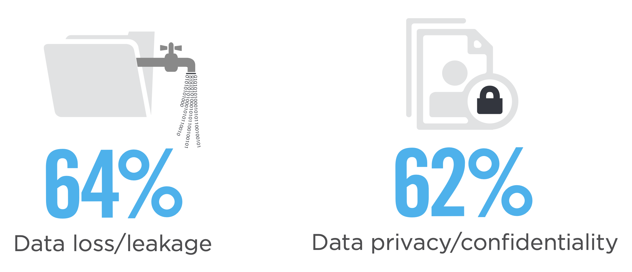
Cloud Security Concerns
Context and Motivation
Source: isc2.org

Slide 8
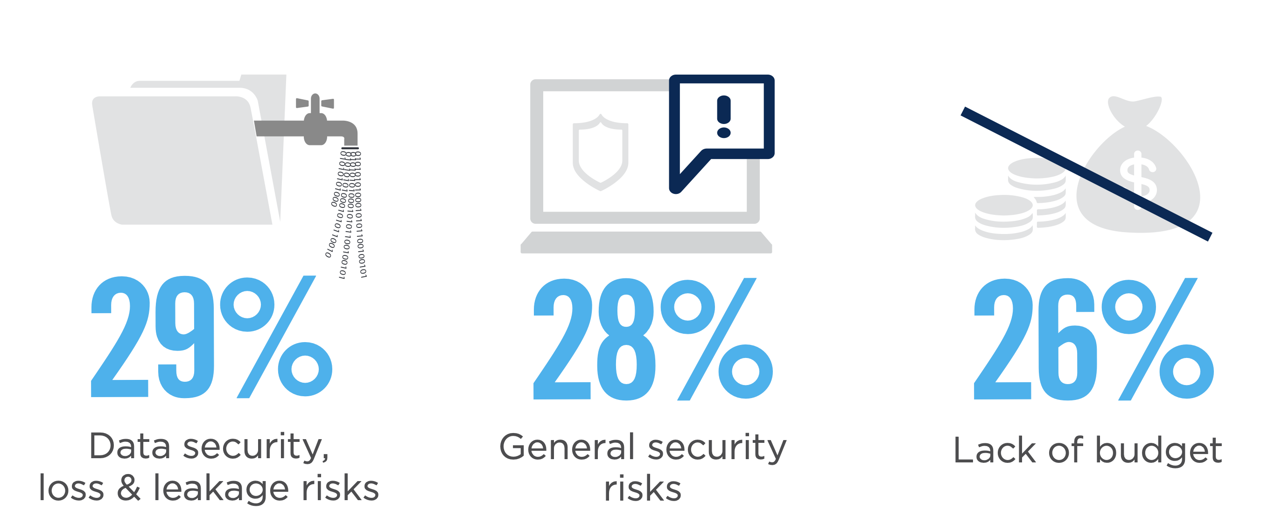
Cloud Adoption Barriers
Context and Motivation
Source: isc2.org
Notes:
Maiores barreiras de quem ainda nao usa são Segurança e não perda de dados. Outros riscos de segurança relacionados com a permanencia de dados fora do espaço fisico e falta de orçamento

Slide 9


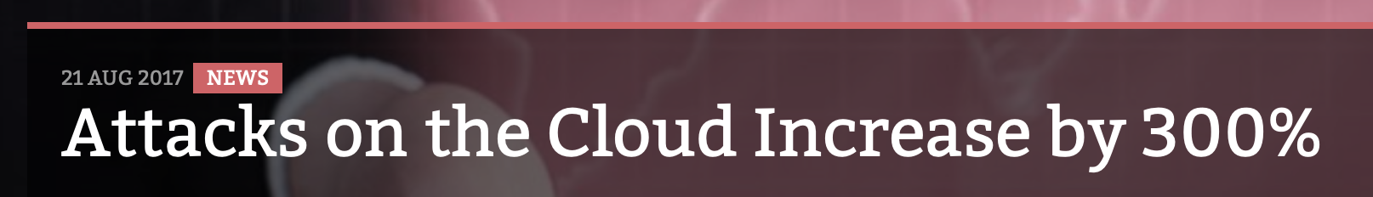
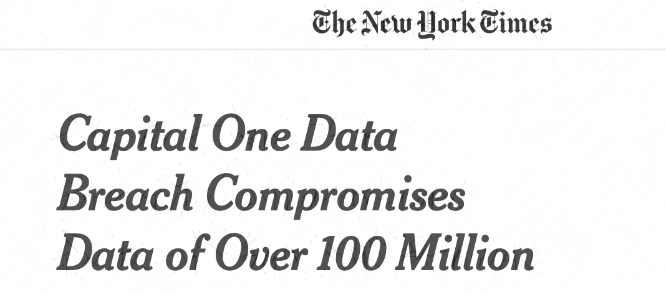
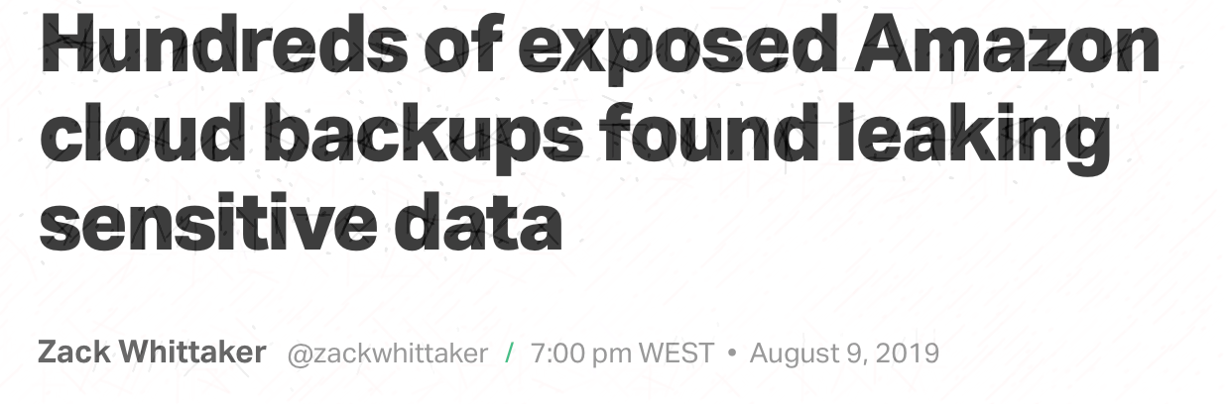
Relevant Events
Context and Motivation
Notes:
Com este aumento de dados e aplicações na cloud, tem se tambem verificado um grande aumento de ataquesaos memos.
Atques a provedores de cloud tem aumentou 300% desde o boom da moviementaçao para a cloud
Focar apenas no exemplo da microsoft

Slide 10
Outline
Dissertation Plan
Context and Motivation
Problem
Objectives and Contributions
Related Work
System Model and Architecture
Approach to Elaboration Phase
Architecture Components and Implementation Guidelines
Testing Environments
Evaluation Criteria
Work Plan
Conclusion
References
Notes:
Todos este eventos levantam 3 problemas

Slide 11


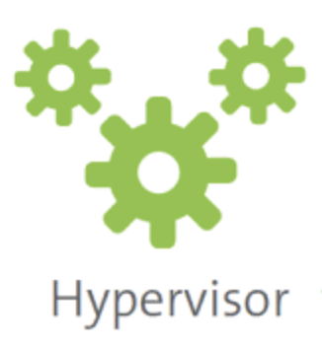
Problem
Dissertation Plan
Insider threats - Honest but Curious model, negligent employee, exploited employee, malicious insiders
Large Trusted Computing Base – Too many components out of users’s control have to be considered trusted
Performance over secure large datasets
Notes:
Ameaças vindas de dentro - Administradores ou staff dos provedores de cloud com acesso fisico e remoto às maquinas
Grande numero de componentes fora do controlo do utilizador em que se tem de confiar para utilizar a cloud como OS, Hipervisores e qualquer software instalado nas maquinas
Performance - Manter todos os dados seguros vai limitar a rapidez e pefromance das plataformas, algo muito importante para muitos

Slide 12
Outline
Dissertation Plan
Context and Motivation
Problem
Objectives and Contributions
Related Work
System Model and Architecture
Approach to Elaboration Phase
Architecture Components and Implementation Guidelines
Testing Environments
Evaluation Criteria
Work Plan
Conclusion
References

Slide 13
Objectives and Contributions
Dissertation Goal
Design and implementation of the cloud-enabled privacy-enhanced solution
Trust-ability, security and privacy
TCB Reduction
Complete Analysis Report
Software attestation
Multiple Replication Mechanisms
Centralised Solution
Master-Slave architecture
Clustering Solution
Isolation
Standard Solution vs. Privacy Enhanced Solution
Notes:
Design e implementação de uma solução para cloud que garanta segurança e privacidade dos dados e do processamento dos mesmos
Varios mecanismos de replicação para a segurar e persistir os dados aumentando a disponibilidade dos dados
Reduzir o numero de componentes fora do controlo do utilizador que podem interferir na segurança dos dados atraves da isolação
Analise completo de uma soluação com mecanismos de seguranca comparando com uma solução standard

Slide 14
Outline
Dissertation Plan
Context and Motivation
Problem
Objectives and Contributions
Related Work
System Model and Architecture
Approach to Elaboration Phase
Architecture Components and Implementation Guidelines
Testing Environments
Evaluation Criteria
Work Plan
Conclusion
References

Slide 15


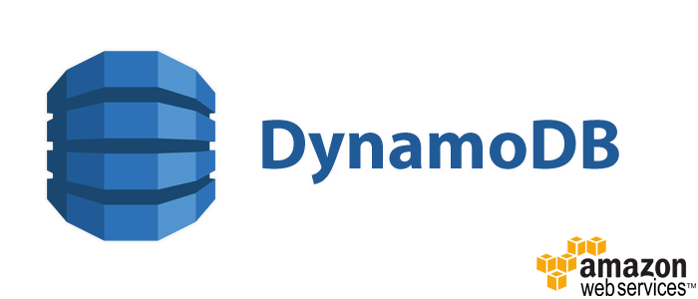


Key Value Stores
Related Work
Primary Concerns
Performance
Simplicity
Secondary Concerns
Security
Availability
Persistence
Replication
Consistency
Notes:
Diferentes tecnologias podemo focar-se mais em um ou outro aspecto secundário mas o enfase será sempre performance e simplicidade, propriedades comuns em todas as tecnologias estudadas

Slide 16

Trusted Execution Environments
Related Work
Loaded code is authentic not tampered by an attacker.
All system state is correct (CPU registers, memory and sensitive I/O).
The code, all data generated and runtime state is confidential.
Notes:
Ambientes de execução confiáveis garantem o processamento dos dados em ambiente seguro sem intreferencia de outros. Todo o estado é correcto, seguro e confidencial
Foram estudadas duas maiores tecnologias SGX e trustzone e ambas tem o mesmo objectivo, garantir isolamento do exterior

Slide 17
Intel SGX
Related Work
Trusted
Untrusted
Application is broken into two parts
Trusted code is isolated by runing and and storing data in Enclaves.
Enclaves are memory regions with strong access control.
Enclave size is limited.
Isolation
Notes:
Garante isolação da zona segura da aplicação correndo em enclaves. As enclaves são zonas de memória com grande controlo de acessos. De notar também que existe limitação ao nivel do tamanho de memória das enclaves.
Garante isolamento do exterior como mostra na figura, nem codigo de sistema previligiado nem sistemas operativos conseguem aceder a dados dentro de enclaves

Slide 18
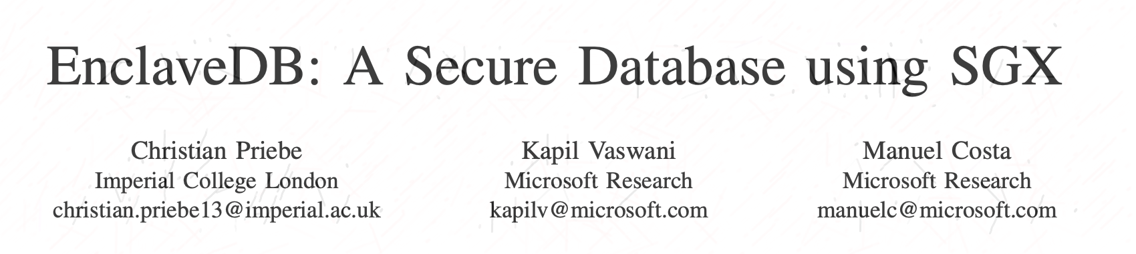
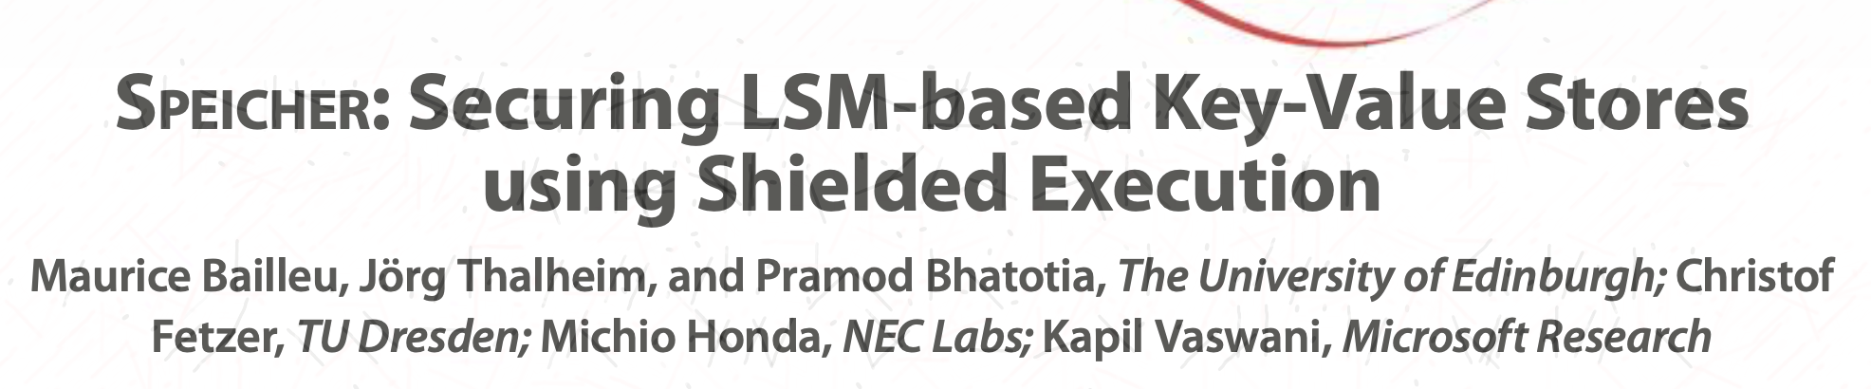
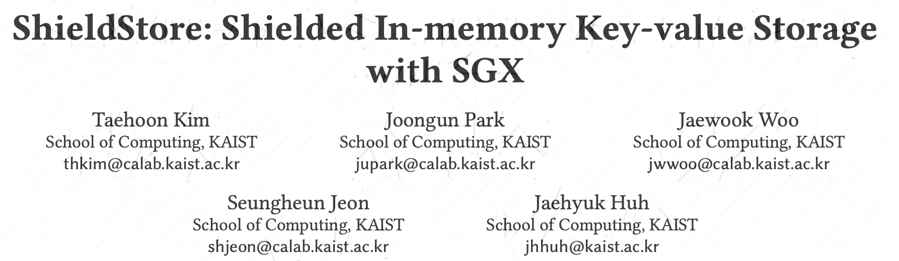
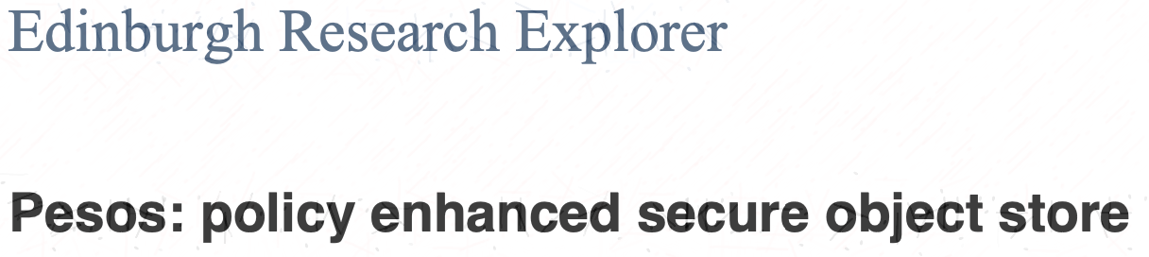
SGX Enabled KVSs
Related Work
Enclave Size Limited
Storage Outside Enclave
Notes:
Estudados varias combinações de key value stores em conjunto com ambientes de execução confiaveis com dois grandes conjuntos. Os que admitem grande memoria para as enclaves e outros que não e guardam dados fora de memoria confiavel
Enclave DB – Simple kvs inside enclave. Relies on page sawpping an admits large memory
Pesos – Object Store inside enclave
Speicher – Optimized for persistence storage
ShieldSTore – Optimised for performance

Slide 19
Outline
Dissertation Plan
Context and Motivation
Problem
Objectives and Contributions
Related Work
System Model and Architecture
Approach to Elaboration Phase
Architecture Components and Implementation Guidelines
Testing Environments
Evaluation Criteria
Work Plan
Conclusion
References

Slide 20
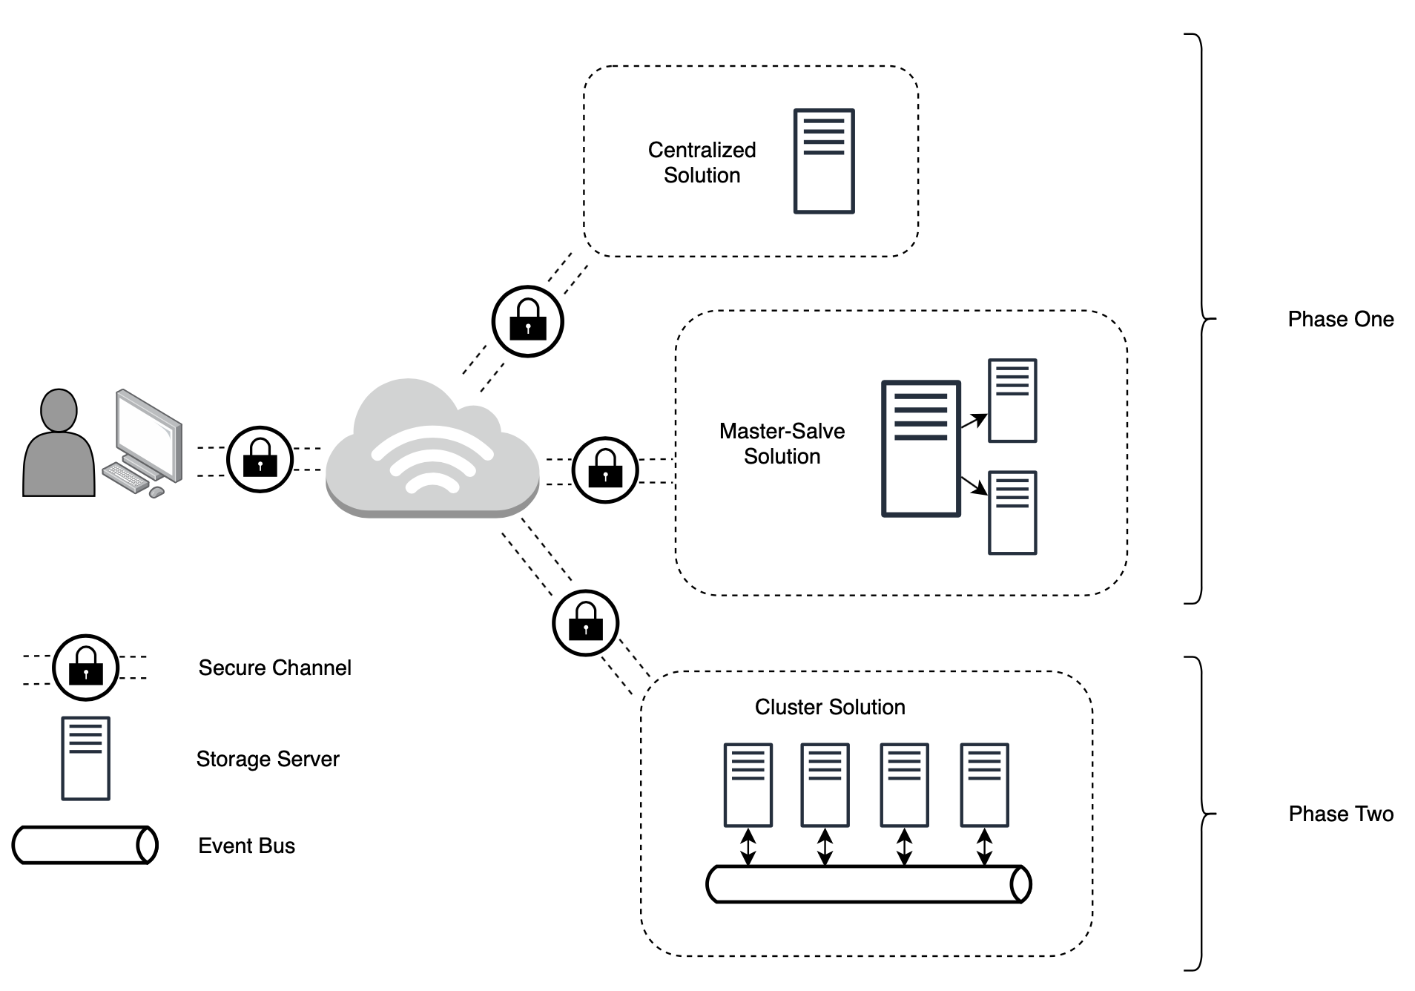
System Model
System Model
Notes:
O modelo pretendido será a comunicação segura de um utilizador para uma aplicação que vive num ambiente cloud, que pode estar distribuida com varios mecanismos diferentes.
O utilizador deve ser abstraido de qualquer detalhe de implementação do sistema

Slide 21
Outline
Dissertation Plan
Context and Motivation
Problem
Objectives and Contributions
Related Work
System Model and Architecture
Approach to Elaboration Phase
Architecture Components and Implementation Guidelines
Testing Environment
Evaluation Criteria
Work Plan
Conclusion
References

Slide 22
Client Side
Architecture Components
Client Security is out of scope.
Manage Homomorphic Encryption Keys.
Represented by benchmark applications:
Redis Benchmark Client
Yahoo! Cloud Serving Benchmark
Notes:
Três grandes components no sistema.
O lado do cliente em que a segurança do mesmo é considerada fora do ambito deste projecto. Será o responsável por controlar as chaves de encriuptação
Representado por um cliente de analise de performance

Slide 23
Communication
Architecture Components
SGX Termination
Backend Node
SGX
HTTPS over TLS/SSL
Notes:
Comunicaççao segura entre o cliente e o servidor que deve terminar dentro de uma ambiente seguro protegendo a comunicação dos varios componentes fisicos ou software de rede que as maquinas tem

Slide 24

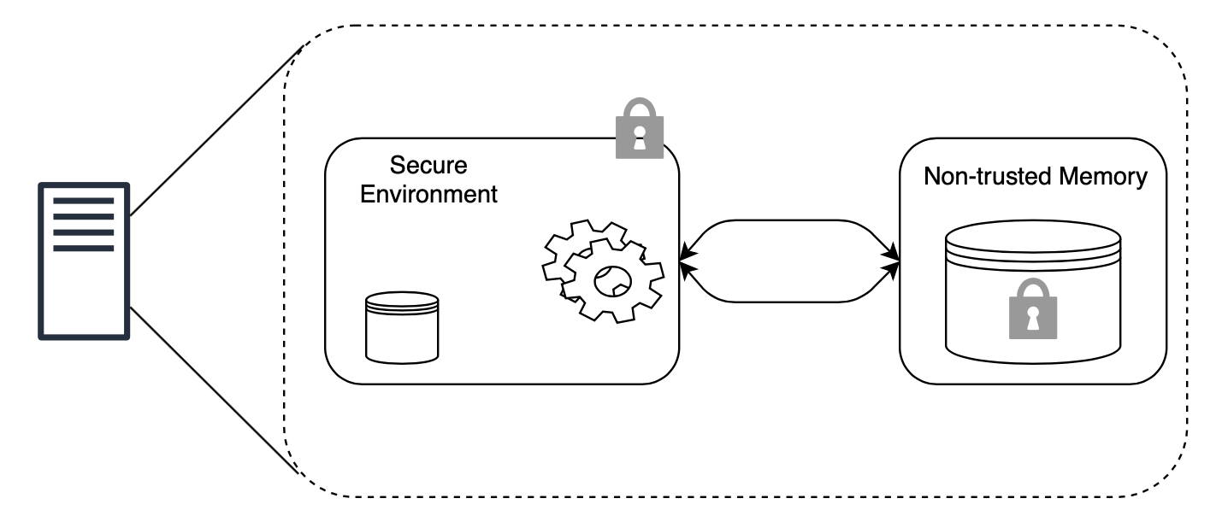
SGX Limitations and Solutions
Implementation Guidelines
Memory
Performance
Notes:
duas grandes limitações com o SGX que vao ser endereçadas da seguinte maneira

Slide 25

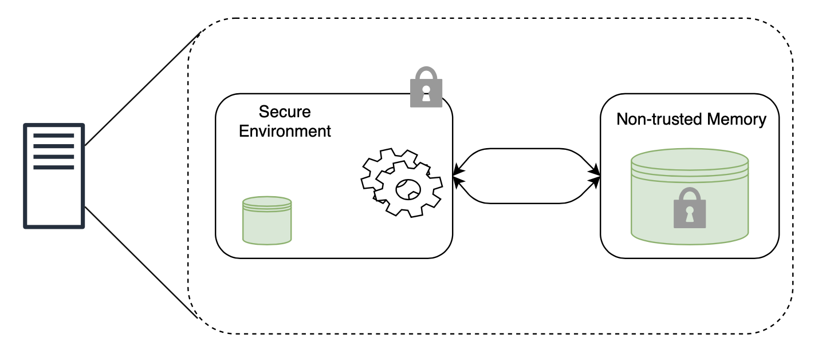
SGX Limitations and Solutions
Implementation Guidelines
Memory
Performance
Hybrid Memory Approach
Notes:
Sistema de aramzenamento hibrido

Slide 26
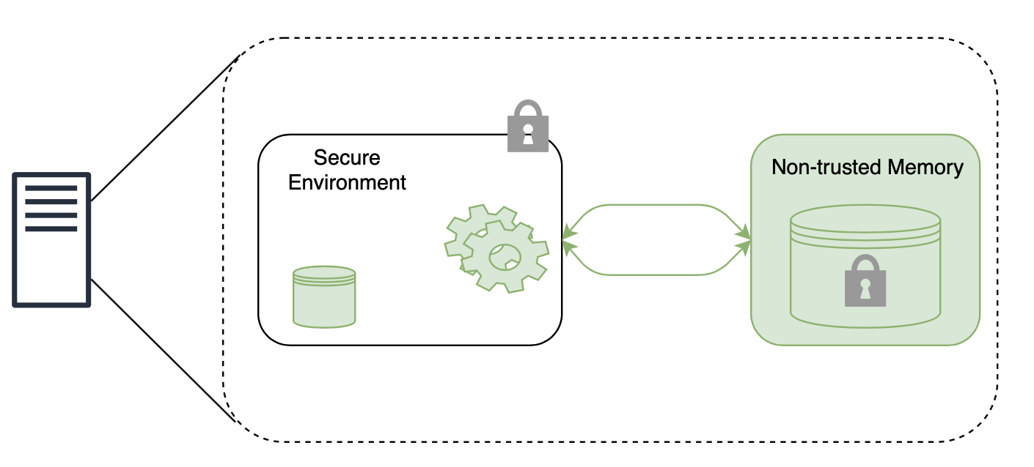
SGX Limitations and Solutions
Implementation Guidelines
Memory
Performance
Hybrid Memory Approach
Homomorphic Encryption
Notes:
Encriptação homomorfica podendo fazer operações sobre bancos de dados cifrados popuando varios ciclos de cifra

Slide 27
Backend Storage Service
Architecture Components
GSC – Graphene SGX Container
Host OS
SGX

Slide 28
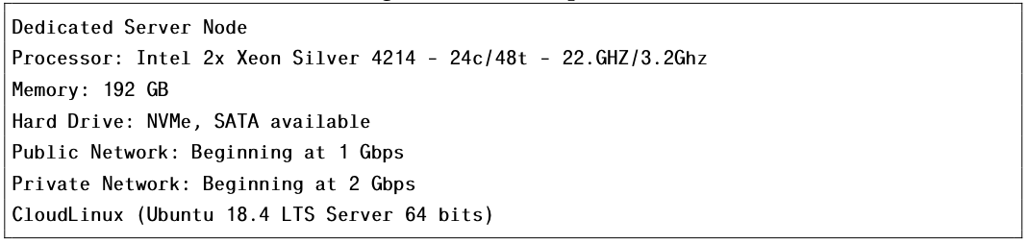
Test Bench Environment
Production Environment
Elaboration Phase

Slide 29
Evaluation Criteria
Elaboration Phase
Performance
Latency
Throughput (ops/s)
Resource Monitoring
Memory Consumption
CPU Load
Power Consumption

Slide 30
Outline
Dissertation Plan
Context and Motivation
Problem
Objectives and Contributions
Related Work
System Model and Architecture
Approach to Elaboration Phase
Architecture Components and Implementation Guidelines
Testing Environments
Evaluation Criteria
Work Plan
Conclusion
References

Slide 31
Planned Tasks/Timeframes
Work Plan
System Model and Architecture Refinement (2 Weeks)
Setup Development Environment
(4 Weeks)
Tests of phase 1 Prototype
Deployment into Production Environment (6 Weeks)
Final Tests and benchmarks
Development of Prototype Phase 1 (8 Weeks)
Development of Prototype Phase 2 (6 Weeks)
Tests of phase 2 Prototype
Dissertation Writing
Notes:
Development of phases timeframe is plus testing. Dissertation writing is done continouasly throughout the time and with specific enfase during the end of some tasks

Slide 32
Outline
Dissertation Plan
Context and Motivation
Problem
Objectives and Contributions
Related Work
System Model and Architecture
Approach to Elaboration Phase
Architecture Components and Implementation Guidelines
Testing Environments
Evaluation Criteria
Work Plan
Conclusion
References

Slide 33
Conclusion
Dissertation Plan
Necessity
Problem
Idea/Contribution
Solution

Slide 34
References
Bibliography
Cloud Benefits; Cloud Security Concerns; Cloud Security Barriers –
https://www.isc2.org/-/media/ISC2/Landing-Pages/2019-Cloud-Security-Report-ISC2.ashx?la=en&hash=06133FF277FCCFF720FC8B96DF505CA66A7CE565https://www.isc2.org/-/media/ISC2/Landing-Pages/2019-Cloud-Security-Report-ISC2.ashx?la=en&hash=06133FF277FCCFF720FC8B96DF505CA66A7CE565
Cloud Adoption; Cloud Revenue - https://www.forbes.com/sites/louiscolumbus/2018/09/23/roundup-of-cloud-computing-forecasts-and-market-estimates-2018/
Recent Events -
https://www.infosecurity-magazine.com/news/attacks-cloud-increase-300/
https://www.cybersecurity-insiders.com/by-2023-cloud-security-spending-to-reach-12-6-billion/
https://www.theguardian.com/technology/2018/nov/21/amazon-hit-with-major-data-breach-days-before-black-friday
https://www.nytimes.com/2019/07/29/business/capital-one-data-breach-hacked.html
https://techcrunch.com/2019/08/09/aws-ebs-cloud-backups-leak/?guccounter=1
https://us.norton.com/internetsecurity-emerging-threats-2019-data-breaches.html
Intel SGX - https://assets.hardwarezone.com/img/2017/02/application_500H.jpg

Slide 35
Key Value Store
Attestation Service
SGX Virtualisation Framework
Key Value Store
Operating System
Hypervisor
Hardware
TEE

Slide 36
Proxy Server
Attestation Service
SGX Virtualisation Framework
Operating System
Hypervisor
Hardware
TEE

